Slide 1
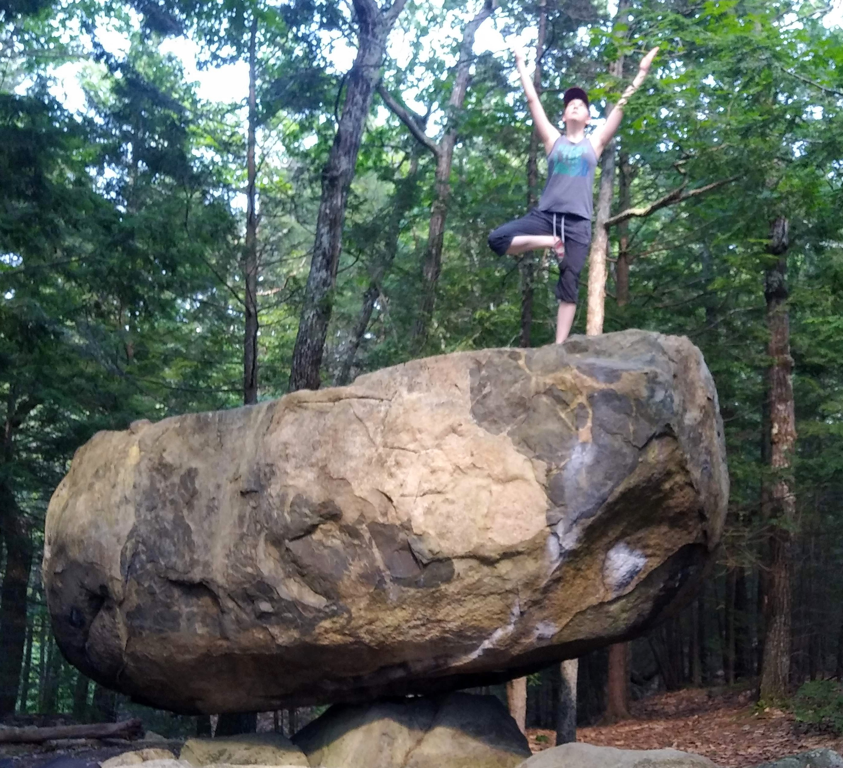
MyClimbs
A Climb Performance Analysis Tool

Slide 2
MyClimbs Problem Space
My daughter and I have been climbing for a while, and decided to create a spreadsheet to track progress a few years back. This spreadsheet has been passed around to friends and family since.
Keeping track of data is one thing, but we wanted the ability to visually represent progress across multiple categories

Slide 3
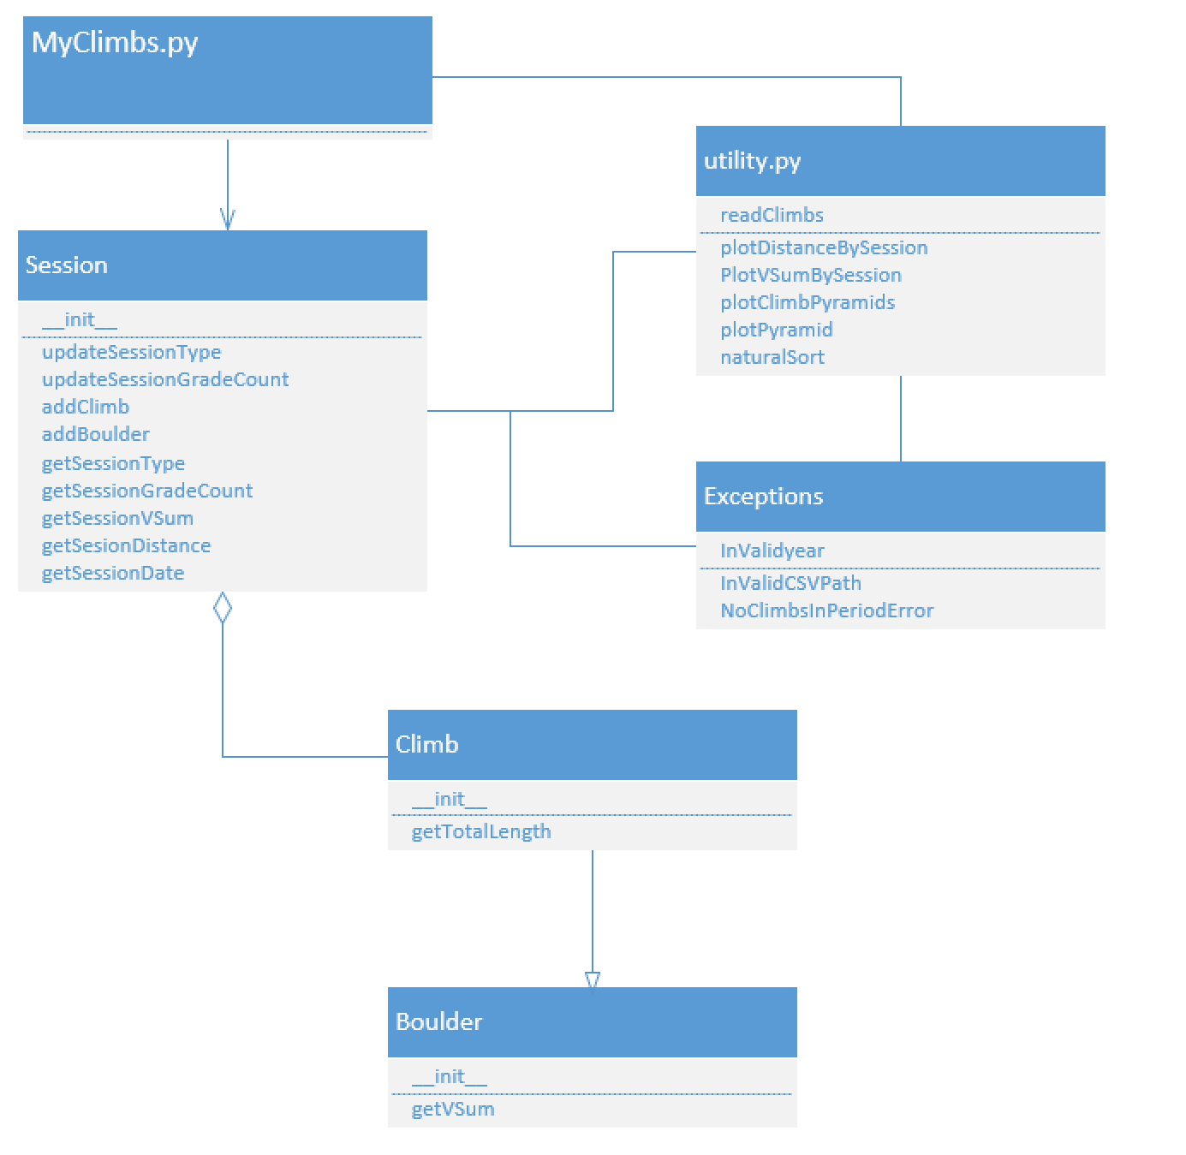
MyClimbs Structure

Slide 4
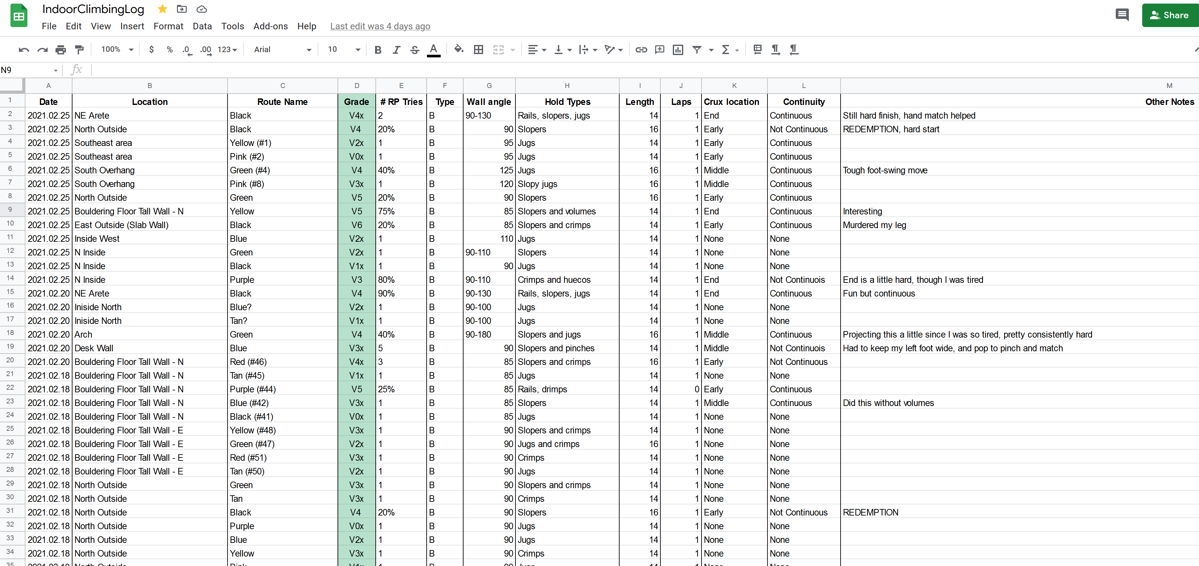
MyClimbs Spreadsheet Template

Slide 5
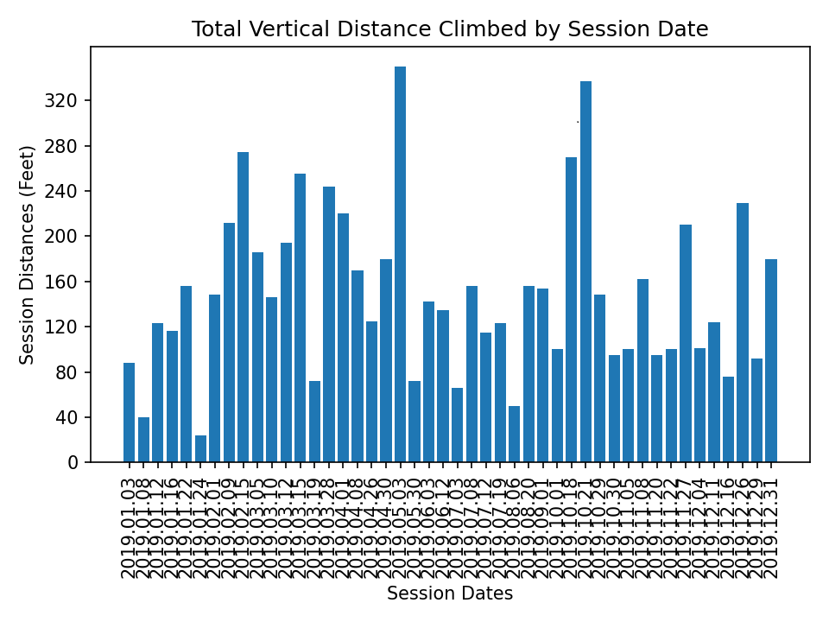
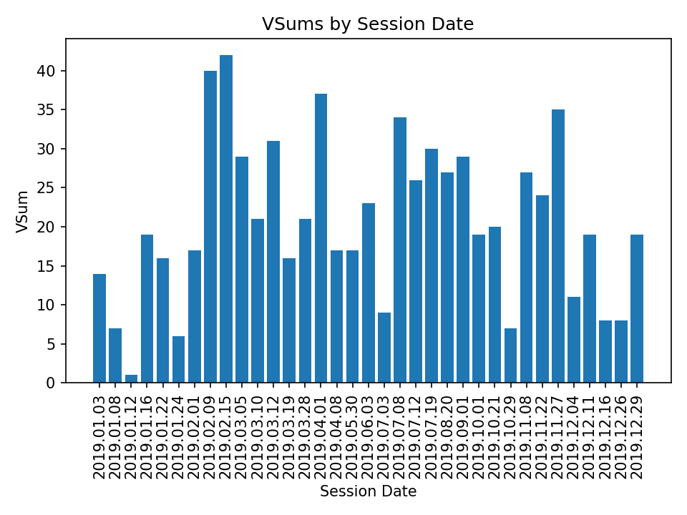
MyClimbs Graphical Output

Slide 6
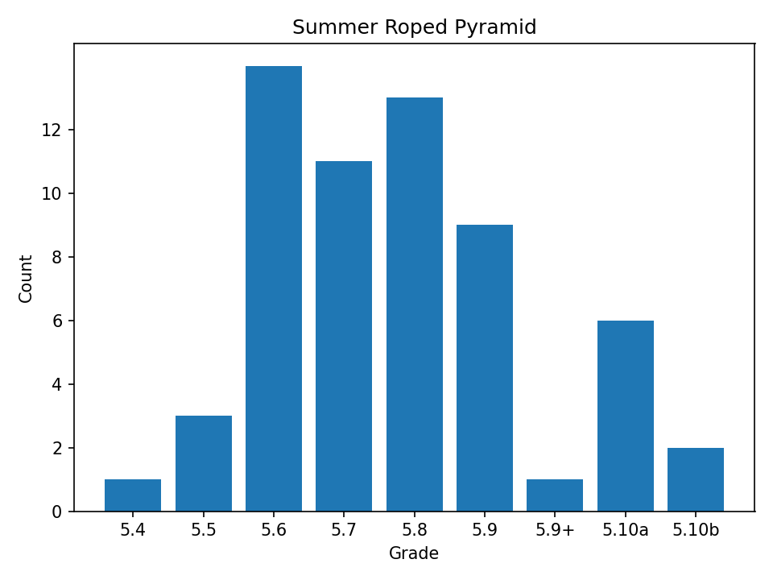
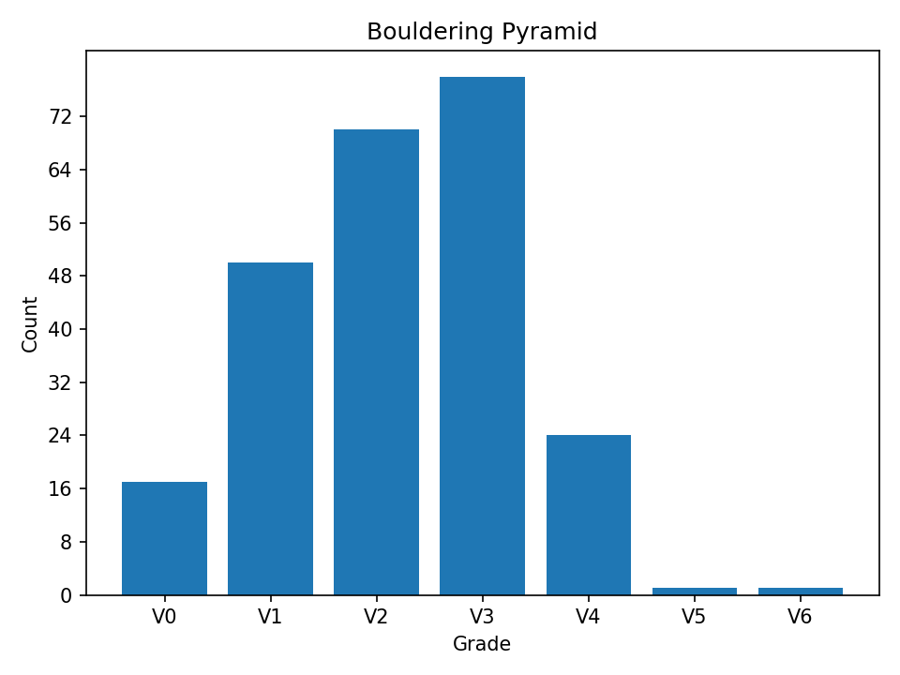
MyClimbs Graphical Output Cont.

